Slide 1

Student_Career_Net
Software Project Presentation

Slide 2

INTRODUCTION

Slide 3





Student_Career_Net

Slide 4

SCOPE & OBJECTIVES

Slide 5



OUR SCOPE
Student Registration
Students can register, upload resumes, and manage their profiles.
Company Registration
Companies can register, view student resumes, and manage job offers.
Admin Dashboard
An admin can manage both student and company accounts and oversee platform activities.
Security
Secure authentication and protection of sensitive user data.
Responsive Design
Ensure that the portal is accessible on various devices such as desktops, tablets, and smartphones.

Slide 6
OUR OBJECTIVES
Providing a secure platform for students to upload their resumes.
Enabling companies to search and filter through student resumes based on various criteria.
Ensuring the system is user-friendly and responsive on all devices.
Maintaining a secure and efficient backend for data management.

Slide 7

SYSTEM ANALYSIS & DESIGN

Slide 8
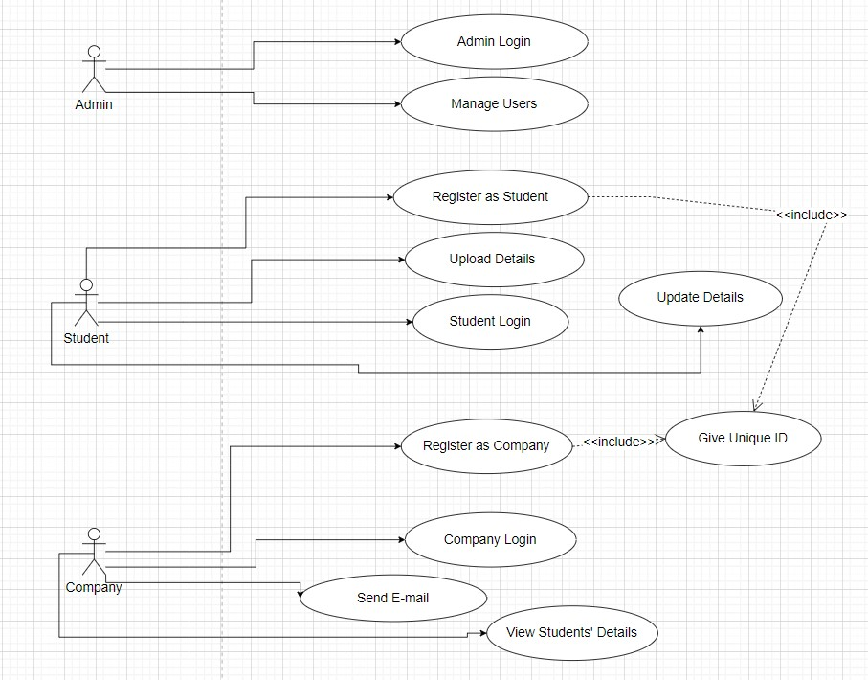
USE CASE DIAGRAM

Slide 9
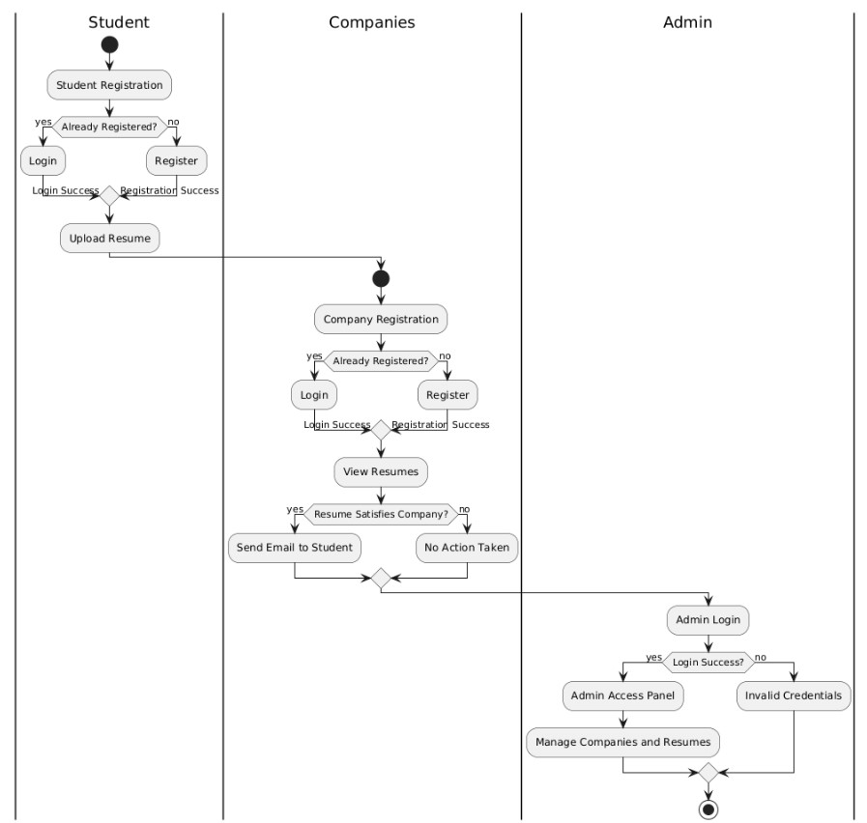
ACTIVITY DIAGRAM

Slide 10
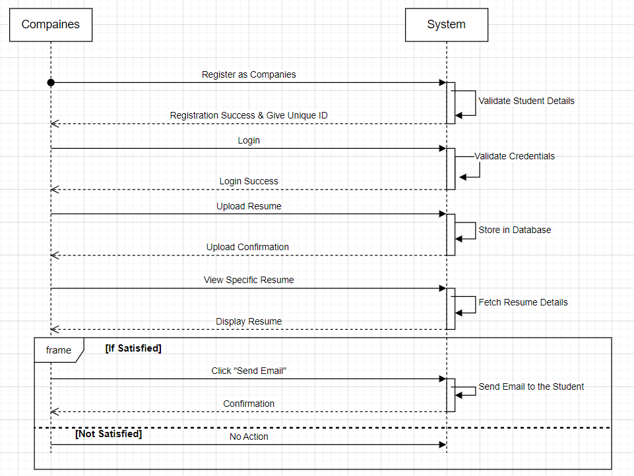
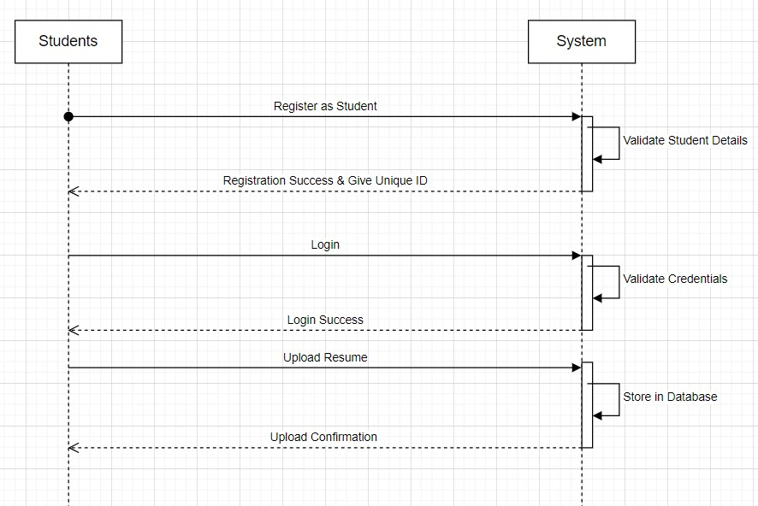
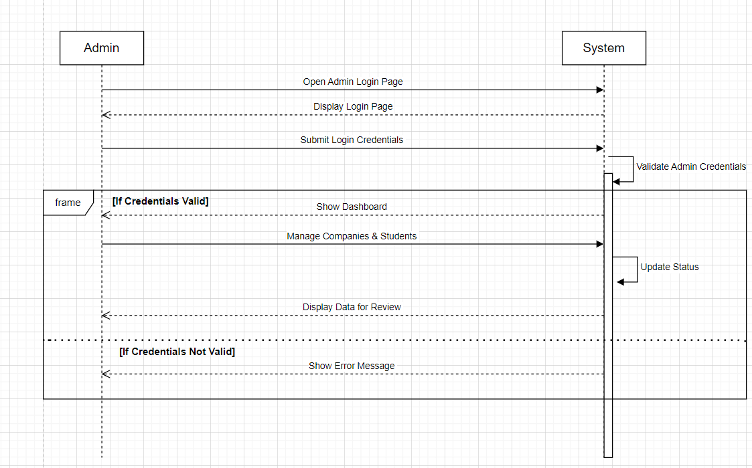
SEQUENCE DIAGRAM
For Student:
For Admin:
For Company:

Slide 11
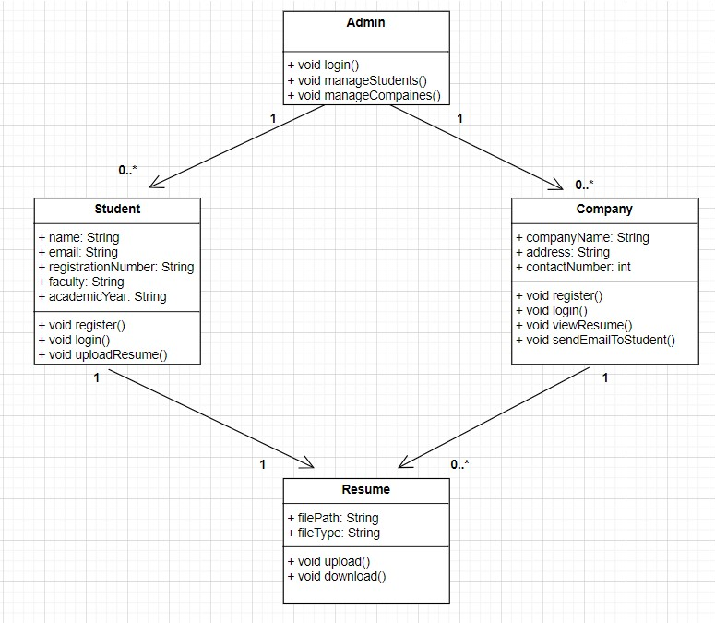
CLASS DIAGRAM

Slide 12

USED LANGUAGES & TOOLS

Slide 13

FRONTEND
The frontend was built using HTML, CSS, and Bootstrap to ensure a responsive and intuitive user experience. The design is simple and user-centric, focusing on ease o navigation.

Slide 14

BACKEND
Technology Stack:
PHP (Sever-Side Language)
XAMMP (Local Development Environment)
Core Functionalities:
User Authentication
Resume Upload
Data Processing
Prevent SQLi
MySQL

Slide 15

DATABASE
Technology Stack:
MySQL Database
Here We create Database Structure including tables for Students, Companies and Admin.

Slide 16

CHALLENGES

Slide 17
CHALLENGES
Database Integration
Students can register, upload resumes, and manage their profiles.
Cross-Browser Compatibility
Ensuring consistent functionality and appearance of the web application across multiple browsers was another challenging task.
Security Concerns
Security was a priority as the platform handles sensitive information such as resumes and personal details.

Slide 18

FUTURE ENHANCEMENTS

Slide 19
FUTURE ENHANCEMENTS
Resume Search Enhancements
Job Notifications
Mobile App
Multilingual Support
Student Resume Update With Admin Permission

Slide 20

GRAPHICAL USER INTERFACE

Slide 21
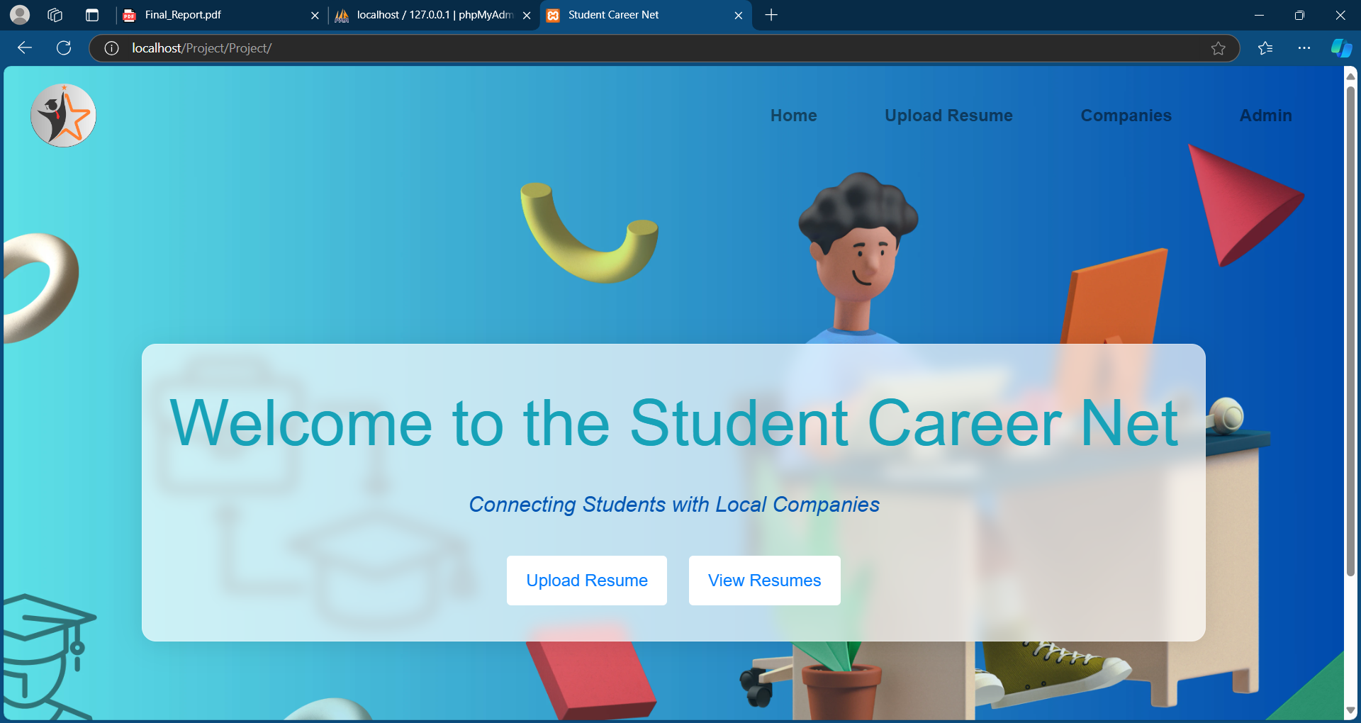
Home Page Screenshot of Student_Career_Net Web site

Slide 22
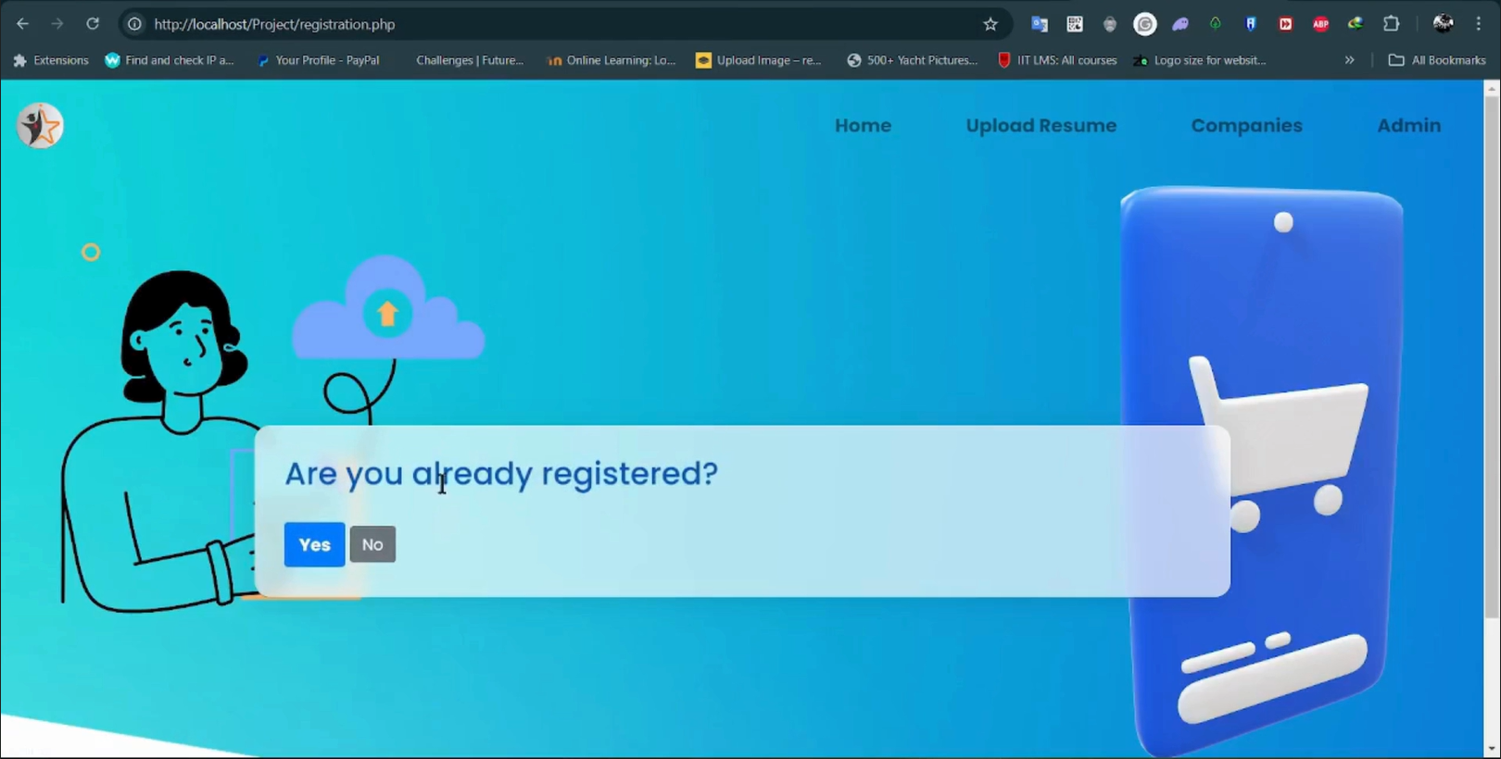
Student Registration & Login Page of Student_Career_Net web site

Slide 23
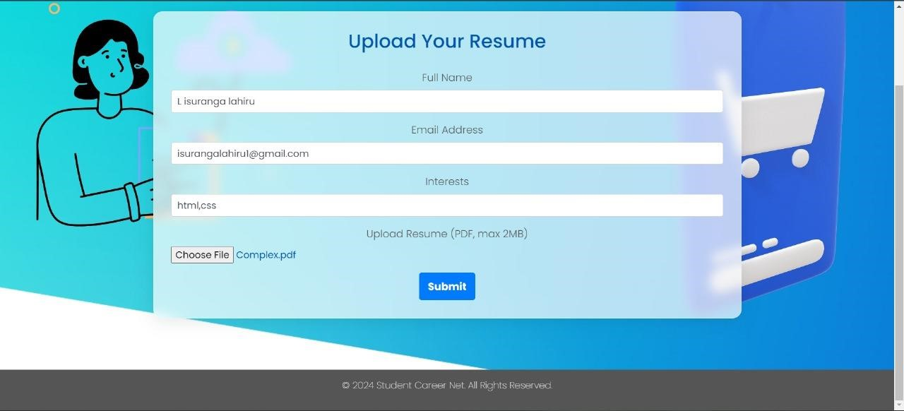
Student Details Upload Page of Student_Career_Net Web site

Slide 24
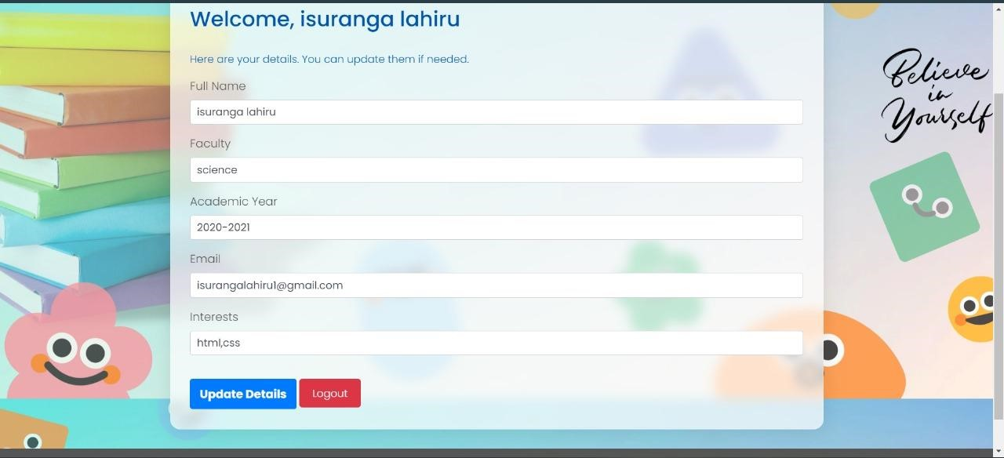
Student Dashboard Page of Student_Career_Net Web site

Slide 25
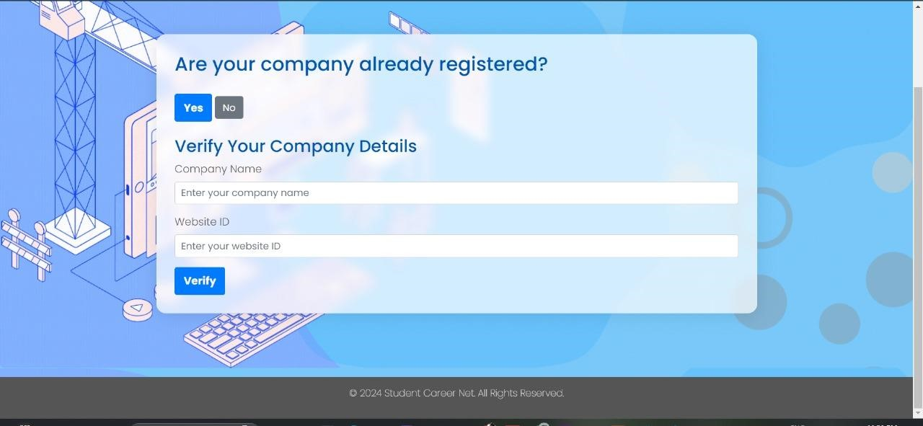
Company Registration & Login Page of Student_Career_Net Web site

Slide 26
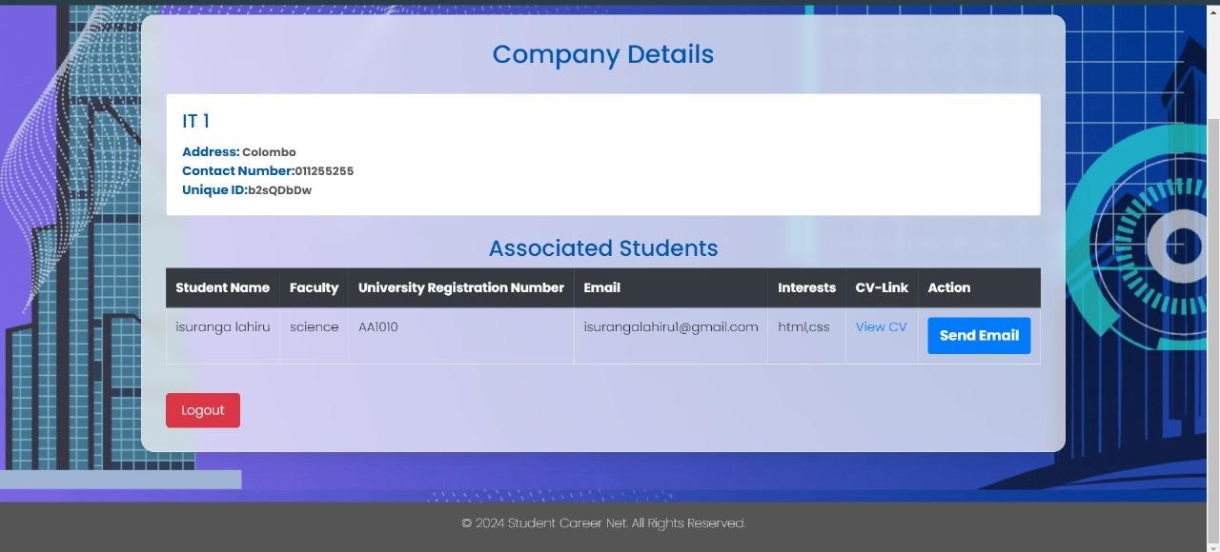
Company Dashboard Page of Student_Career_Net Web site

Slide 27
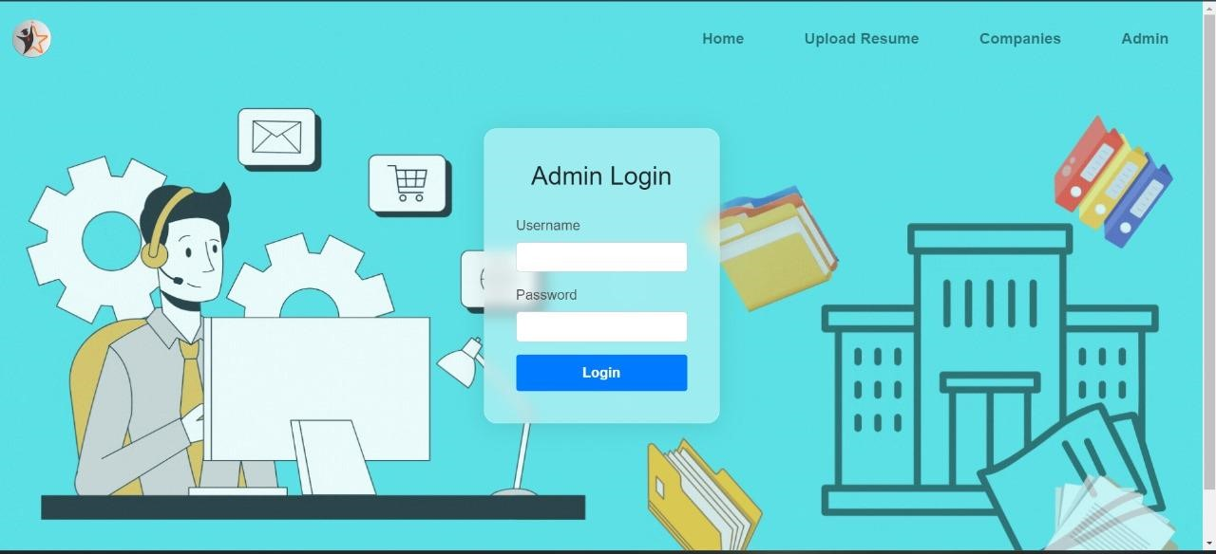
Admin Login Page of Student_Career_Net Web site

Slide 28
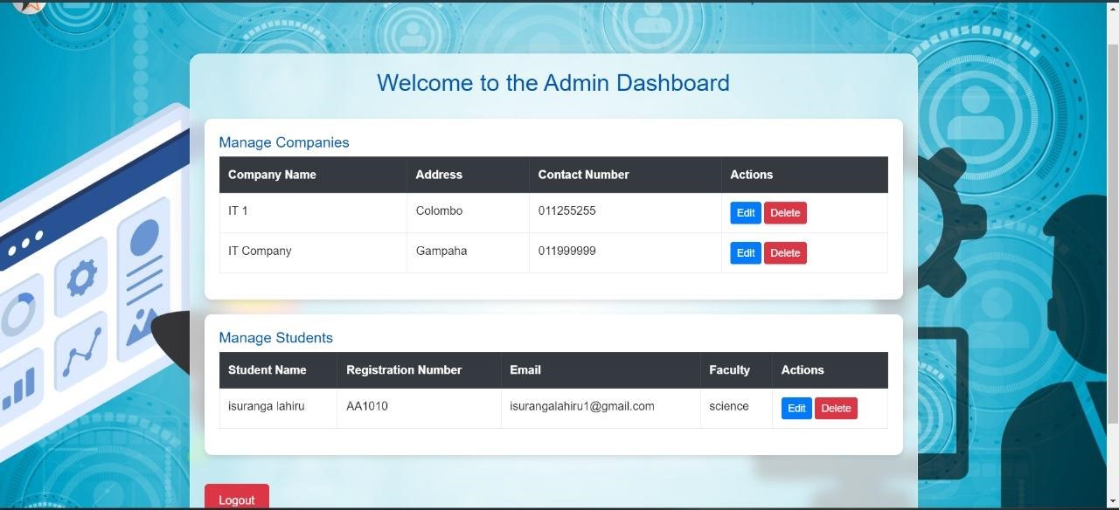
Admin Dashboard Page of Student_Career_Net Web site

Slide 29
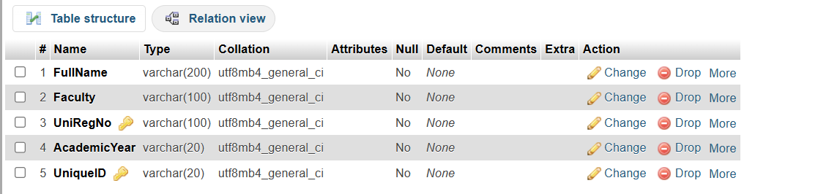
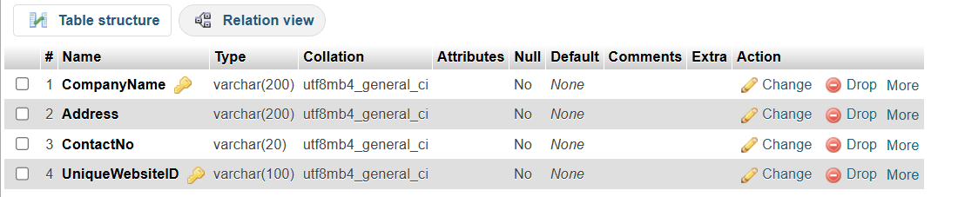
Studnt Table of Student_Career_Net System Database
Company Table of Student_Career_Net Database

Slide 30
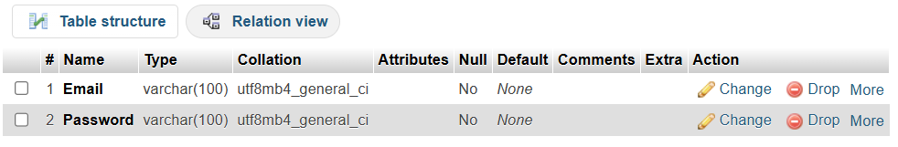
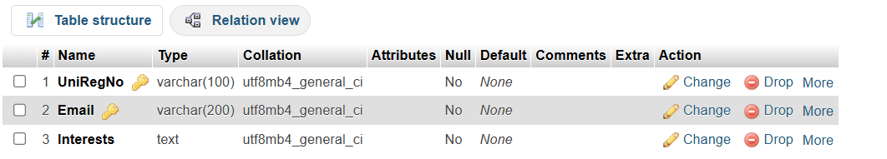
Admin Login Table of Student_Career_Net Database
Stdent Update Table of Student_Career_Net Database

Slide 31





THE TEAM
Tharushi
Isuranga
Tharaka
Shanuka

Slide 32

THANK YOU!

